Slide 1
Molecular Biology Biol 480
Lecture 5 January 18, 2019

Slide 2
Announcements/Assignments
New articles to read:
Squirrels with prion diseases
Artificial nucleotides in DNA
Since we have Monday, off I am encouraging you to access and READ the lab carefully this weekend. You will need to start a broth culture of a colony of bacteria, from the LB-A, and LB-A-A plates. Each pair of students should start a colony growing in LB broth. This needs to be done, Tuesday, any time after noon. We need a healthy culture of bacteria on Wed. at 10 am.

Slide 3
Where were we…more on nucleic acids
H-bonds---a common type of non-covalent bond in macromolecules
Spectrophotometry to analyze nucleic acids—
What is spectrophotometry?
What is “optical density” of a substance?
Do all substances have the same absorbance characteristics?
How is spectrophotometry used to analyze DNA?

Slide 4
Where were we…?
This display can be absorbance, or transmission—which tells optical density?
What wavelength would you use to analyze DNA or RNA---Why?

Slide 5
Spectrophotometry can be used to analyze the amount/concentration and characteristics of DNA sequence (degree/nature of repetitive DNA) in a DNA sample.
The analysis takes advantage of the complementary base-pairing of the DNA strands.

Slide 6
Denaturation/renaturation kinetics
DNA is a really durable molecule—
What, specifically is durable?
But DNA can be denatured and in controlled conditions, renatured.
How can you detect DNA that is being denatured?

Slide 7
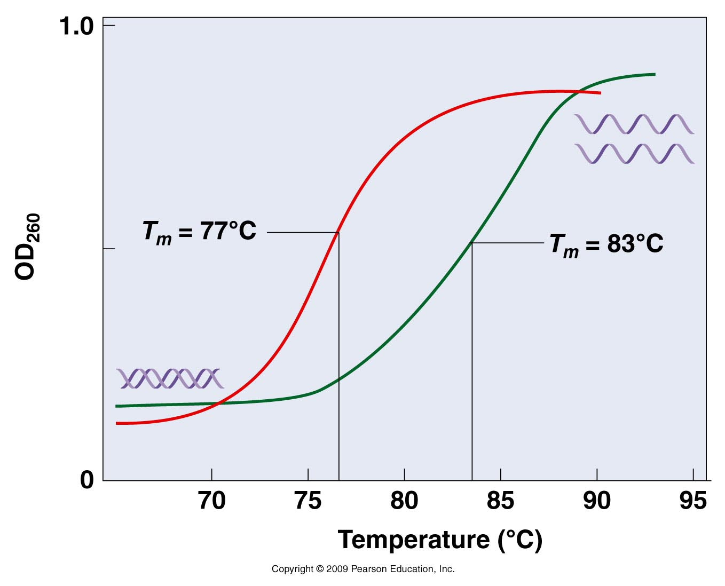
What is Tm? Speculate on a possible difference in the 2 samples shown.
Figure 10.20
Notes:
Figure 10.20 Increase in UV absorption vs. temperature (the hyperchromic effect) for two DNA molecules with different GC contents. The molecule with a melting point of 83° C has a greater GC content than the molecule with a of 77° C.

Slide 8
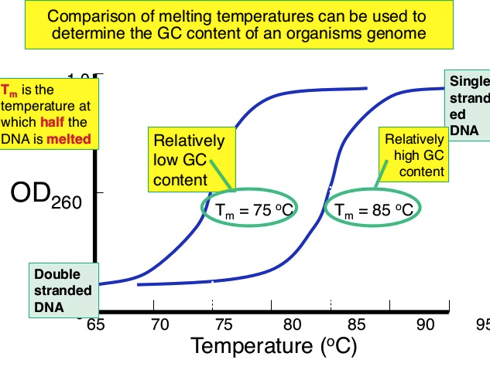
Figure 10.16
Sigmoidal curve showing denaturing of DNA

Slide 9
Likewise…
If you cool the DNA slowly you can allow the bases to reform and the DNA renatures or reassociates into double strands.
As renaturation occurs, the OD decreases until all the DNA is double stranded.
What might the curve look like?

Slide 10
Renaturation/reassociation kinetics tells you something about the DNA sequence.
Think hard about the nature of the 2 DNA strands making up a double helix (duplex)….
What might slow or speed the reassociation of DNA strands?
(figure 10-16)

Slide 11
Using reassociation kinetics to analyze repetitive sequence in DNA
DNA from different organisms can be analyzed using DNA denaturing and reassociation kinetics.
Isolate all the DNA from cells of an organism
Fragment the DNA into uniform size fragments
3. Denature/melt DNA with heat
4. Cool DNA to allow reassocation of DNA strands
5. At the same time, measure OD₂₆₀ over time.

Slide 12
Next Slide
Make some conclusions from this experiment.
Start with basic observations, then look more deeply at the data.

Slide 13
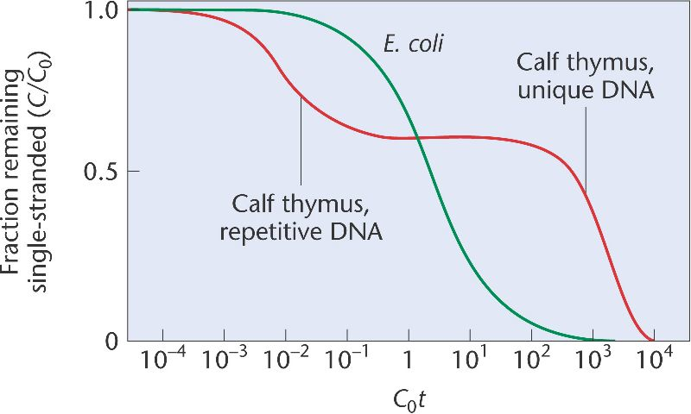
OD₂₆₀
Time

Slide 14
The more repeats in the genome of an organism, the faster the renaturation. Why?
Renaturation occurs in phases or fractions.
Be able to interpret a reassocation curve.

Slide 15
Many modern molecular biology analysis techniques are based on denaturation and renaturation behavior of DNA.
Given the right conditions any 2 complementary strands of nucleic acid will form base pairs.
DNA can can reassociate with DNA
DNA can even reassociate with RNA

Slide 16
Because the process can occur with DNA-DNA strands that were not necessarily part of the same DNA molecule or even with one DNA and one RNA strand, the molecule that forms is referred to as a hybrid molecule.
The process of making 2 sections of DNA or DNA and RNA form base pairs is called hybridization.

Slide 17
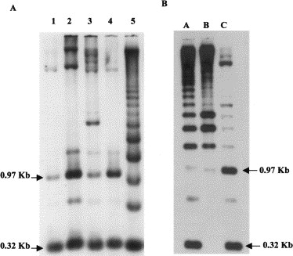
The dark spots on this figure show where a specific sequence of DNA is located in a mixture of DNA fragments.
A radioactive DNA or RNA probe was hybridized to the DNA. The probe annealed with complementary sequence and can be seen because of its radioactive nature

Slide 18
DNA probes can even be hybridized to intact chromosomes to locate and analyze specific sequences. The process is known as in situ hybridization. Today the DNA probes can be fluorescently labelled to make it easy to visualize the location of a sequence of interest. The process is called Fluorescence in situ Hybridization (FISH).
Figure 10-19

Slide 19
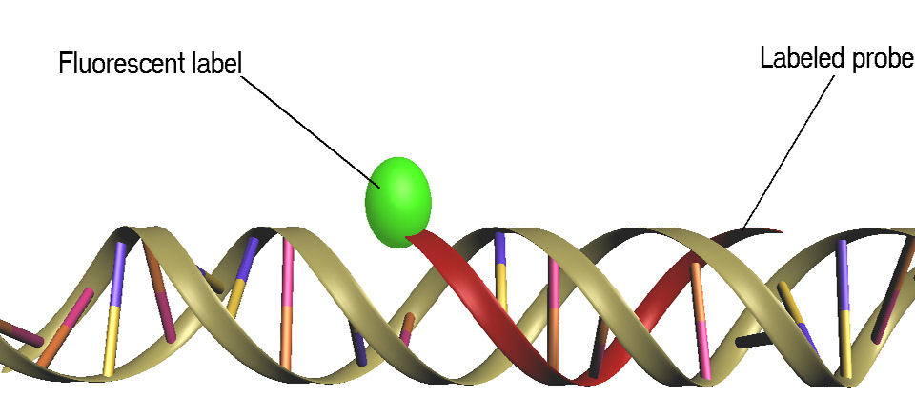

Slide 20
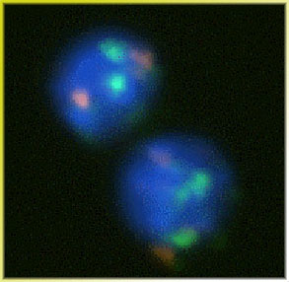
2 cells in interphase, probed with sequences from 2 genes. (One probe linked to a red molecule, one probe linked to a green molecule?
Why 4 spots of fluorescence?

Slide 21
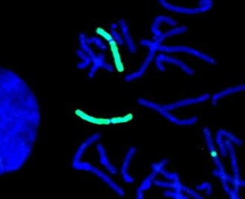
Probing can be done on mitotic chromosomes

Slide 22
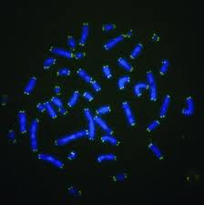
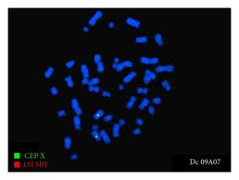
Telomere sequence probe

Slide 23
Measuring DNA size
DNA size can be a confusing concept.
We can think of DNA as a molecule with a corresponding molecular weight.

Slide 24
What’s the molecular weight of Adenine? Adenosine triphosphate?

Slide 25
Nucleotide Molecular Weights
Nucleotide MW (g/mol)
Deoxyribonucleotide triphosphates (Avg. MW = 487.0)
dATP 491.2
dCTP 467.2
dGTP 507.2
dTTP 482.2
Deoxyribonucleotide Monophosphates (Avg. MW = 327.0)
dAMP 331.2
dCMP 307.2
dGMP 347.2
dTMP 322.2
What is the MW of a DNA molecule 100,000,000 nucleotides in length? (Use average MW)

Slide 26
More commonly, we think of DNA molecules in numbers of nucleotides---and we refer to the length in base-pairs.

Slide 27
Human chromosomes
Millions of base pairs
http://en.wikipedia.org/wiki/Human_genome

Slide 28
Measuring DNA size
Early molecular biologists relied on centrifugal force to “settle” molecules present in a solution.
Centrifugation can be used to collect substances with densities greater than the solvent. Many techniques have been used to allow one to separate Nucleic acid molecules of different size by using solutions of different densities.
Sometimes referred to as sedimentation analysis

Slide 29
Purification and analysis of DNA after sedimentation involved many subsequent steps and other methods are used more often now.
Nevertheless…you read of molecules described by a sedimentation measure (Svedberg units) used to describe nucleic acids (RNA) and proteins.
18S ribosomal RNA
80S ribosomal subunit

Slide 30
Ribosomal RNA is still described as “s” size

Slide 31
Early techniques for purifying DNA often used a sedimentation solution. DNA was centrifuged through a solution of known density or through a solution of varying density—known as a density gradient. DNA molecules of different size would sediment to their corresponding density.
Cesium Chloride was commonly used for this type of purification

Slide 32
Centrifugal force

Slide 33
In the years just before I was in graduate school, plasmid purification would have involved separation by centrifugation in centrifuges bigger than a washing machine, fairly nasty chemicals, and several days of work.

Slide 34
Electrophoresis of Nucleic acids
Figure 10-20
More modern/common way of separating nucleic acids—usually fragments of a DNA.
Migration through a porous matrix via electrical attraction
Size and charge dependent
DNA migrates toward a positive pole in an electrical field. Migration is inversely proportional to the length of the DNA molecule.

Slide 35
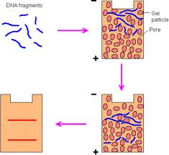
Agarose Gel electrophoresis

Slide 36
Range of applications
Depending on the application, different gels are used which have different pore sizes.
Electrophoresis can be used to separate whole chromosomes (a technique called pulsed gel field electrophoresis)
Electrophoresis can resolve/separate DNA fragments of 100s-1000s of bases in size.
Electrophoresis can even separate DNA that differs by only in a single nucleotide (100 vs. 101 nucleotides in length)

Slide 39
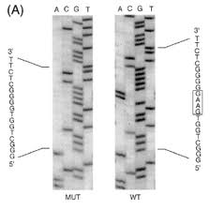
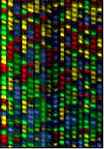
Electrophoresis is the basic technique behind sequencing of genomes.

